Slide 1
CEN511: EMBEDDED SYSTEMS DESIGN AND PROGRAMMING
COURSE LECTURERS
ODUSAMI MODUPE (Engr.)
OMORUYI OSEMWEGIE

Slide 2
Module 5- Serial Communication In Microcontrollers
UART
SPI
I2C

Slide 3
UART
UART: Stands for Universal Asynchronous Reception and Transmission (UART)
A simple serial communication protocol that allows the host communicates with the auxiliary device. UART supports bi-directional, asynchronous and serial data transmission.
It has two data lines, one to transmit (TX) and another to receive (RX) which is used to communicate through digital pin 0, digital pin 1. TX and RX are connected between two devices. (eg. USB and computer).
UART can also handle synchronization management issues between computers and external serial devices.

Slide 4
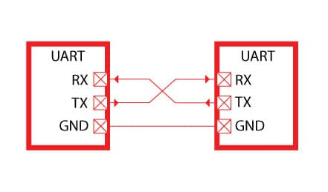
UART

Slide 5
UART
It can operate between devices in 3 ways:
Simplex
Half-Duplex
Full Duplex
Simplex equals data transmission in one direction. Half-duplex means data transmission in either direction but not simultaneously.
Full-duplex equals data transmission in both directions simultaneously. Once connected, data flows from TX to RX of the receiving UART. As UART is an asynchronous serial transmission it requires no clocks.
Transmitting UART converts parallel data from the master device (e.g. CPU) into serial form and transmit in serial to receiving UART. It will then convert the serial data back into parallel data for the receiving device.

Slide 6
SPI
Serial Peripheral Interface (SPI) is an interface bus commonly used to send data between microcontrollers and small peripherals such as shift registers, sensors, and SD cards.
It uses separate clock and data lines, along with a select line to choose the device you wish to talk to.

Slide 7
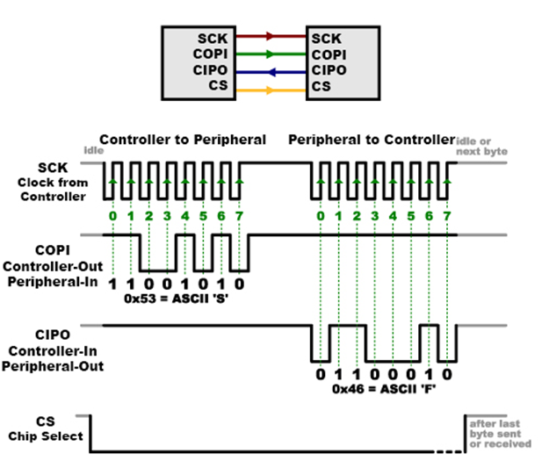
SPI

Slide 8
SPI
It's a "synchronous" data bus, which means that it uses separate lines for data and a "clock" that keeps both sides in perfect sync. The clock is an oscillating signal that tells the receiver exactly when to sample the bits on the data line. This could be the rising (low to high) or falling (high to low) edge of the clock signal; the datasheet of the microcontroller in use will specify which one to use. When the receiver detects that edge, it will immediately look at the data line to read the next bit.
In SPI, only one side generates the clock signal (usually called CLK or SCK for Serial Clock). The side that generates the clock is called the "controller", and the other side is called the "peripheral". There is always only one controller (which is almost always your microcontroller), but there can be multiple peripherals (more on this in a bit).

Slide 9
SPI
When data is sent from the controller to a peripheral, it's sent on a data line called COPI, for "Controller Out / Peripheral In".
If the peripheral needs to send a response back to the controller, the controller will continue to generate a prearranged number of clock cycles, and the peripheral will put the data onto a third data line called CIPO, for "Controller In / Peripheral Out".

Slide 10
I2C
I2C is a serial protocol for two-wire interface to connect low-speed devices like microcontrollers, EEPROMs, A/D and D/A converters, I/O interfaces and other similar peripherals in embedded systems.
I2C bus is popular because it is simple to use, there can be more than one master, only upper bus speed is defined and only two wires with pull-up resistors are needed to connect almost unlimited number of I2C devices.
I2C can use even slower microcontrollers with general-purpose I/O pins since they only need to generate correct Start and Stop conditions in additiOn to functions for reading and writing a byte.

Slide 11
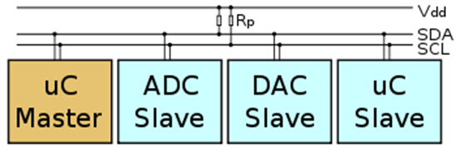
I2C

Slide 12
I2C
Each slave device has a unique address. Transfer from and to master device is serial and it is split into 8-bit packets. All these simple requirements make it very simple to implement I2C interface even with cheap microcontrollers that have no special I2C hardware controller. You only need 2 free I/O pins and few simple i2C routines to send and receive commands.
The initial I2C specifications defined maximum clock frequency of 100 kHz. This was later increased to 400 kHz as Fast mode. There is also a High speed mode which can go up to 3.4 MHz and there is also a 5 MHz ultra-fast mode.

